Slide 1
Most popular GAN architectures
CycleGAN
StyleGAN
LSGAN
DiscoGAN

Slide 2
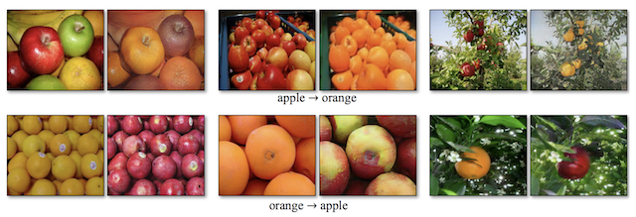
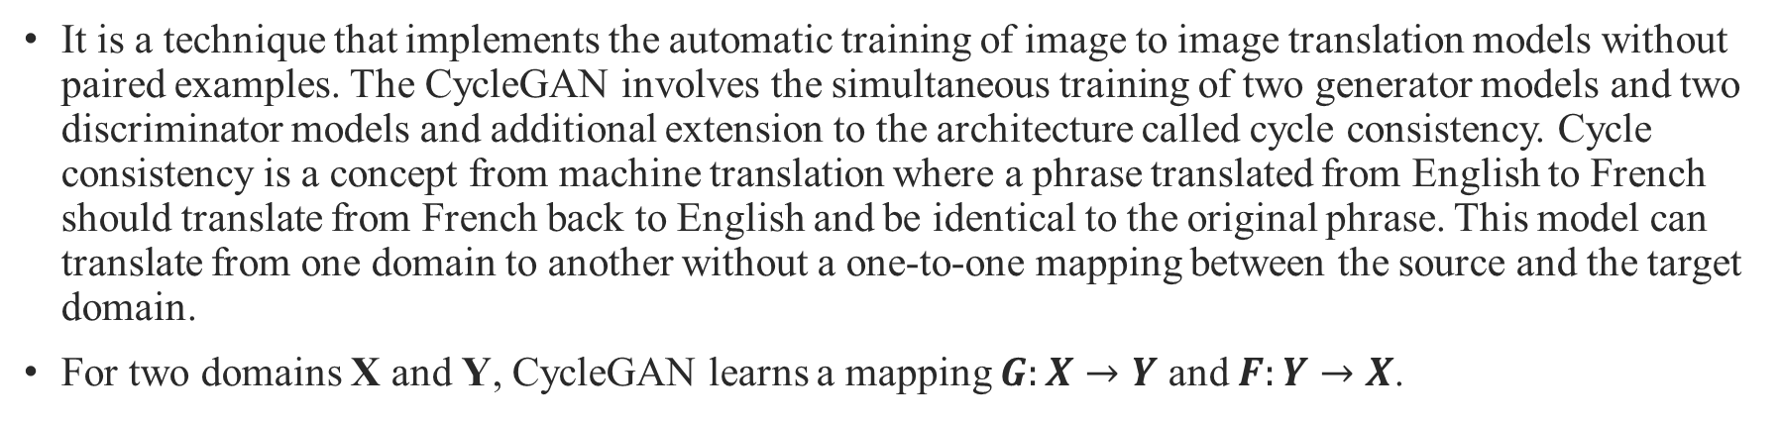
CycleGAN
It is a technique that implements the automatic training of image to image translation models without paired examples. The CycleGAN involves the simultaneous training of two generator models and two discriminator models and additional extension to the architecture called cycle consistency. Cycle consistency is a concept from machine translation where a phrase translated from English to French should translate from French back to English and be identical to the original phrase. This model can translate from one domain to another without a one-to-one mapping between the source and the target domain.
For two domains X and Y, CycleGAN learns a mapping $G:X→Y$ and $F:Y→X$.

Slide 3
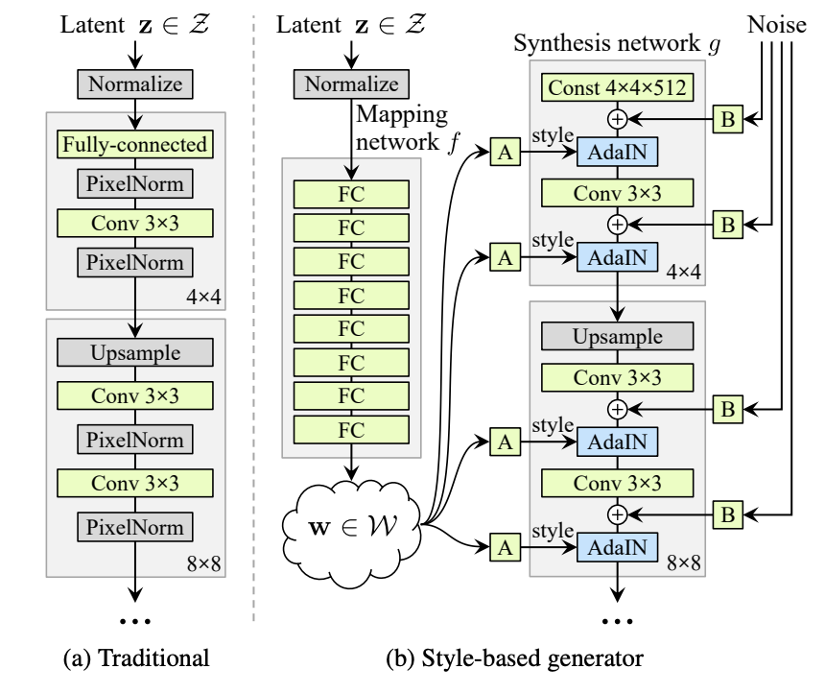
StyleGAN
Introduced by Nvidia researchers, StyleGAN is a novel generative adversarial network. The StyleGAN is an extension to the GAN architecture that proposes large changes to the generator model, including the use of a mapping network to map points in latent space to an intermediate latent space, the use of the intermediate latent space to control style at each point in the generator model, and the introduction to noise as a source of variation at each point in the generator model.
The resulting model is capable not only of generating impressively photorealistic high-quality photos of faces, but also offers control over the style of the generated image at different levels of detail through varying the style vectors and noise.

Slide 4
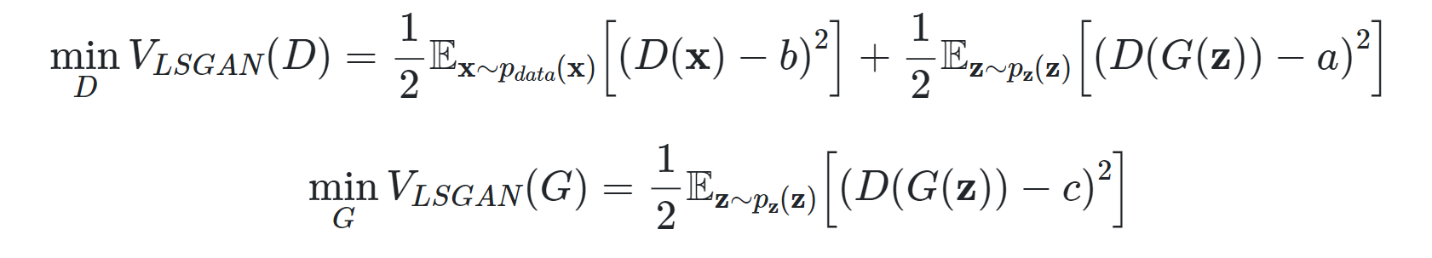

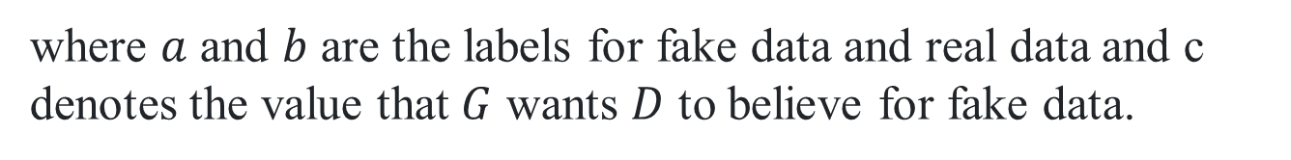
LSGAN(Least Square Adversial Network)
LSGAN, or Least Squares GAN, is a type of generative adversarial network that adopts the least squares loss function for the discriminator. Minimizing the objective function of LSGAN yields minimizing the Pearson $χ^{2}$divergence.
The objective function can be defined as:
where $a$ and $b$ are the labels for fake data and real data and c denotes the value that $G$ wants $D$ to believe for fake data.

Slide 5
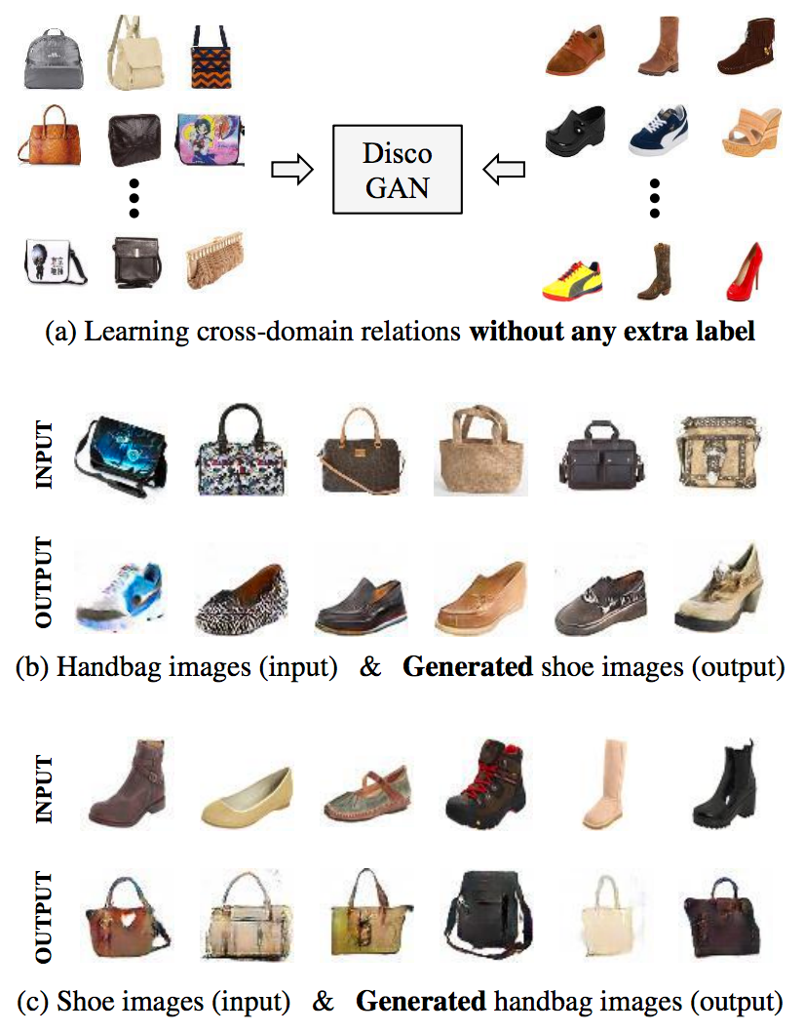
DiscoGAN
It generates images of products in domain B given an image in domain A. It transfers elements from one image to another. DiscoGAN has two generators. The first generator maps the input image from Domain A to Domain B. The second generator reconstructs the image from Domain B to Domain A.
There is a slight similarity between CycleGAN and DiscoGAN. In CycleGAN it has an addition hyperparameters to adjust the contribution of reconstruction/cycle-consistency loss in the overall loss function. DiscoGAN can be used for transferring decoration from a fashion item such as a bag to another fashion item as a pair of shoes.

